Slide 1
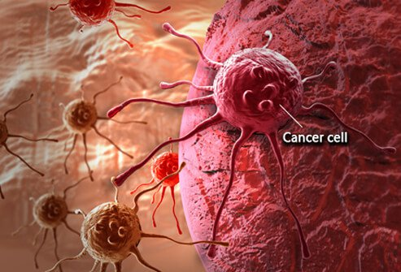
Lecture 1 :
Properties of normal and cancer cells; Hallmarks

Slide 2
What is Cancer
Normal cells adhere to the strict set of rules and signals that determine whether cells should divide, differentiate, or die
Cancer cells bypass regulations by these signals leading to uncontrolled growth and proliferation
Cancer is the uncontrolled growth of abnormal cells anywhere in a body
It is a genetic disease,
Inherited cancer
Sporadic cancer

Slide 3
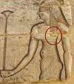
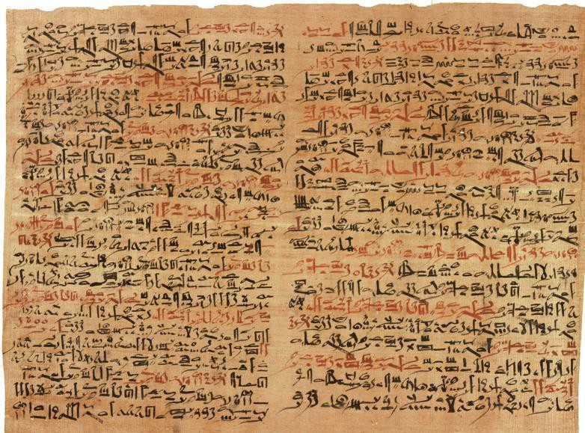
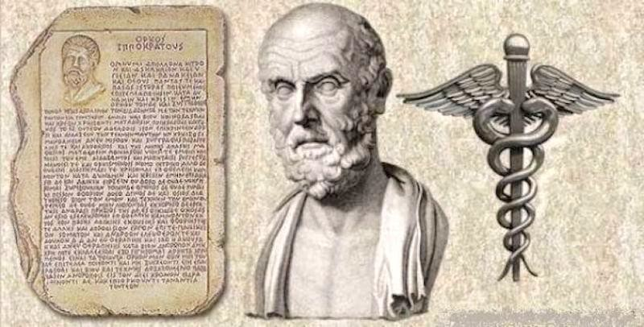
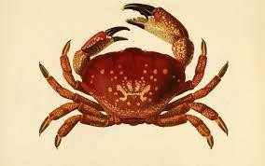
DESCRIBED IN HISTORY
First described by the Egyptians
  3000 BC
  Edwin Smith papyrus
    1862,Thebes
    Bulging tumor of the breast was a grave disease with no treatment
Hippocrates
  Greek physician, 400 B.C.
  Opposed superstition and believed that tumors
were initiated by natural causes
  Named disease “KARKINOS”
    GREEK = CRAB
Google images

Slide 4
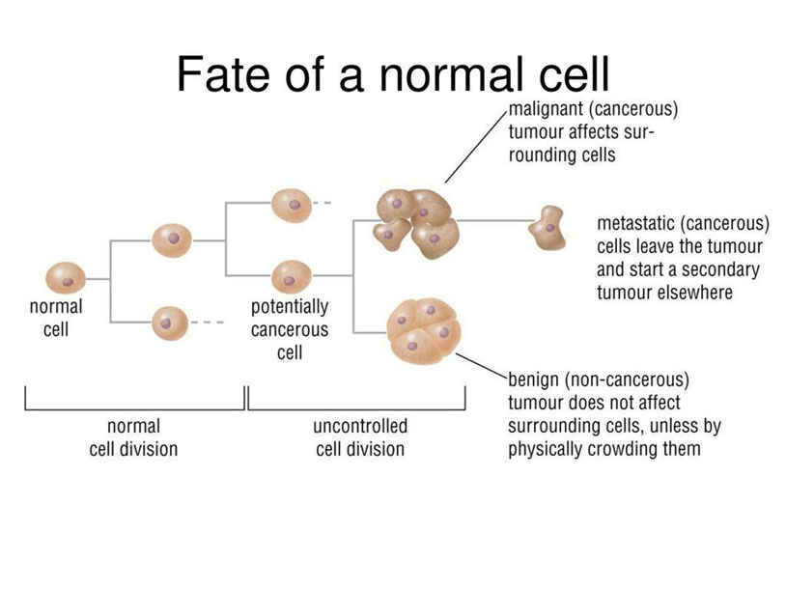
PROPERTIES OF CANCER CELLS:
Uncontrolled mitotic divisions
Cells exhibit number of genetic alterations
Loss of limitations on the number of cell division
Lack of contact
inhibition

Slide 5
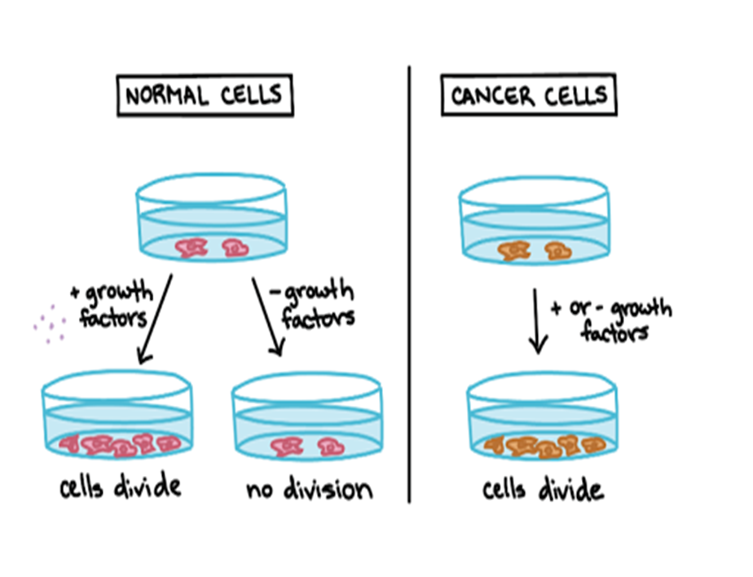
Ability to grow in culture
Cells are less adhesive than normal cells.
Lack differentiation
They lose sensitivity

Slide 6
TYPES:
National cancer Institute - common types:
Bladder Lung
Breast Melanoma
Endometrial Kidney cancer
Leukemia Lymphoma
Pancreatic Prostate
Thyroid Colon & rectal

Slide 7
Cancer symptoms:
Depends on the types
General symptoms:
Fatigue Weight loss Skin changes Pain
Unusual bleeding Persistent cough Fever

Slide 8
What is a tumor
Tumor is derived from the Latin root tumor, swelling, condition of being swollen, a tumor
Due to uncontrolled growth a tumor is formed
Most cancer form tumors, but not all tumors are cancerous

Slide 9
Benign and Malignant tumors
Benign
non cancerous tumor
Malignant
cancerous tumor
Benign tumors (non-cancerous) have a suffix of ‘oma’
(e.g. adenoma)
Malignant tumors (cancerous) have a suffix of ‘carcinoma’ or ‘sarcoma’ (e.g. adenocarcinoma)

Slide 10
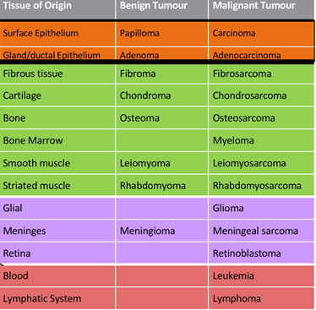
Classification based on tissue of origin
Name reflects
tissue of origin & stage
Epithelial
Connective
Tissue and
Muscle
Brain
Hematolo-
gical

Slide 11
Classification (Contd)
Epithelial cancers make up majority of cancers
Solid malignancies (epithelial)
Haematological malignancies
(haematological)

Slide 12
Process and Steps ….
What is the process through which a normal cell becomes a cancer cell?
What are the steps required for a primary tumour to give rise to other tumours through invasion & metastasis. What are those “hallmark capabilities" to do that?
Is development of a cancer that possess hallmark capabilities a multi-step process?

Slide 13
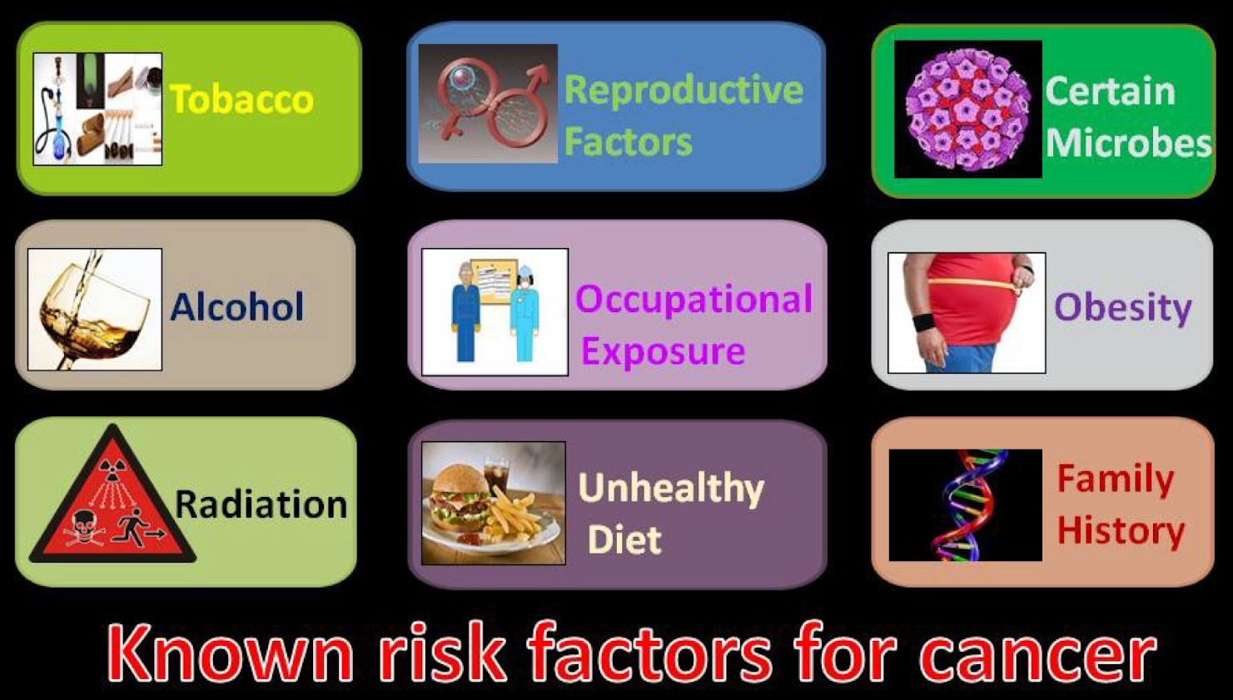
Process by which a normal cell becomes a cancer cell
Risk Factors
Cancer risk factors result in genetic mutations/changes which drive cell transformation
Transformation : process (transition) from normal cell to cancer cell

Slide 14
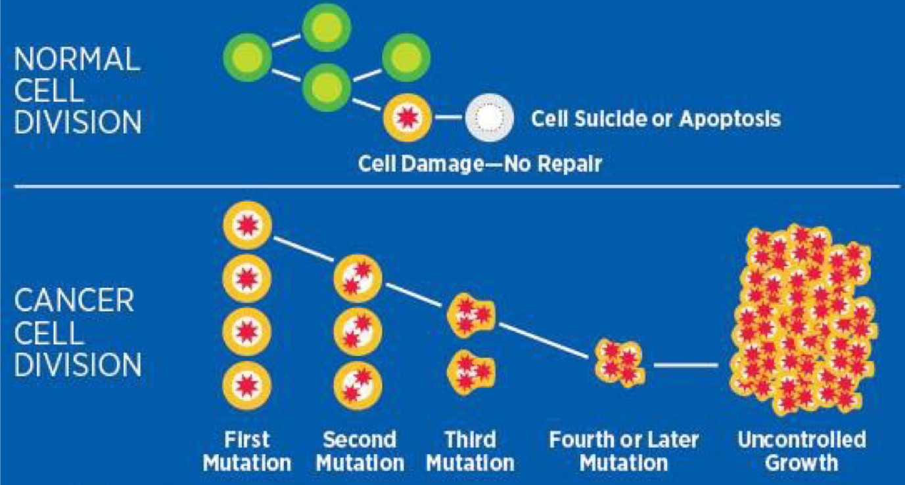
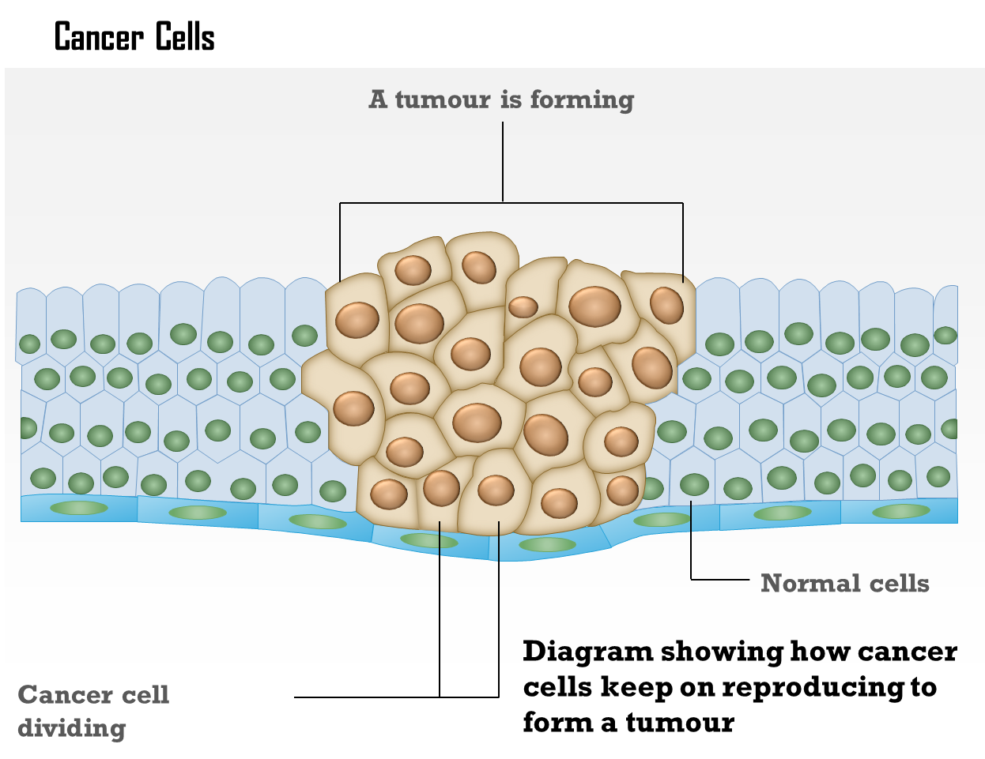
Process from normal cell to cancer cell …..
Cancer risk factors result in genetic mutations/changes which drive cell transformation
Transformation : process (transition) from normal cell to cancer cell
Epigenetic & genetic changes lead to:
  Loss of tumour suppressor genes expression (e.g. p53)
  Expression of oncogenes (e.g. mutant EGFR)

Slide 15
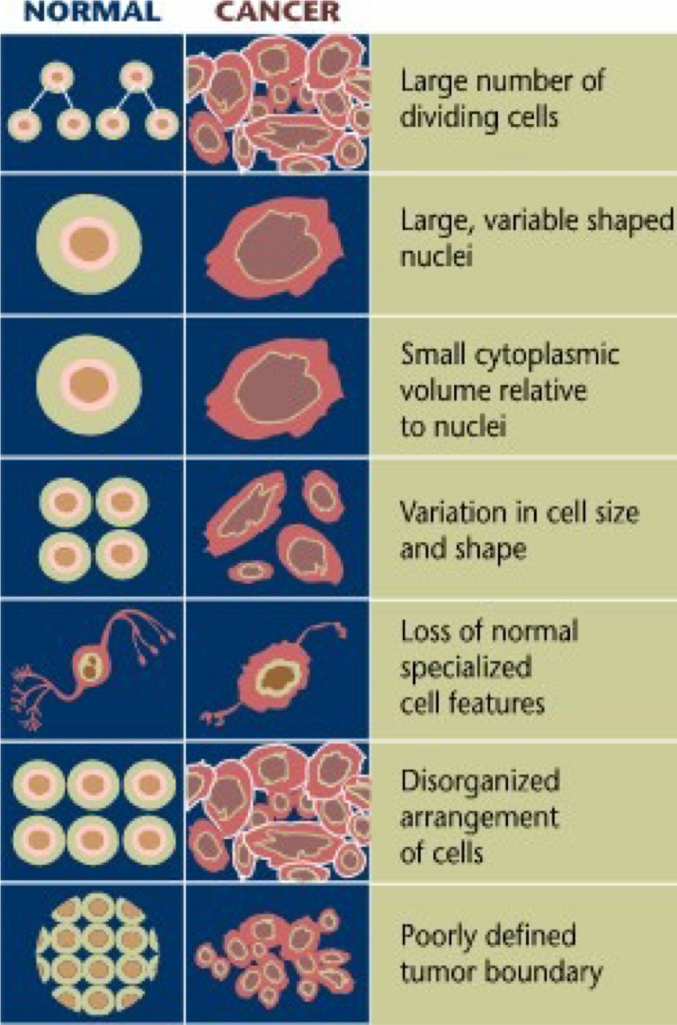
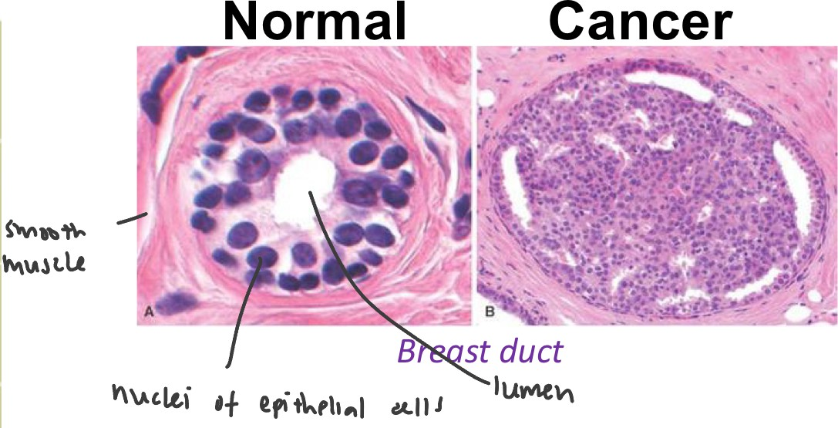
Phenotypic differences between normal & cancer cells

Slide 16
Normal vs Cancer cells examples
Normal astrocytes (brain, supporting cells) Glioblastoma cells (nuclei shapes differ)
Cancerous smooth muscle tissue (see arrow)

Slide 17
Cancer cells can form in the cervix, but first the cells of the cervix go through abnormal changes called dysplasia.
There are different types of dysplasia.
Mild dysplasia is low-grade intraepithelial lesion (LSIL)
Moderate or severe dysplasia, called high-grade intraepithelial lesion (HSIL) is another type of dysplasia.
LSIL and HSIL may or may not become cancer.

Slide 18
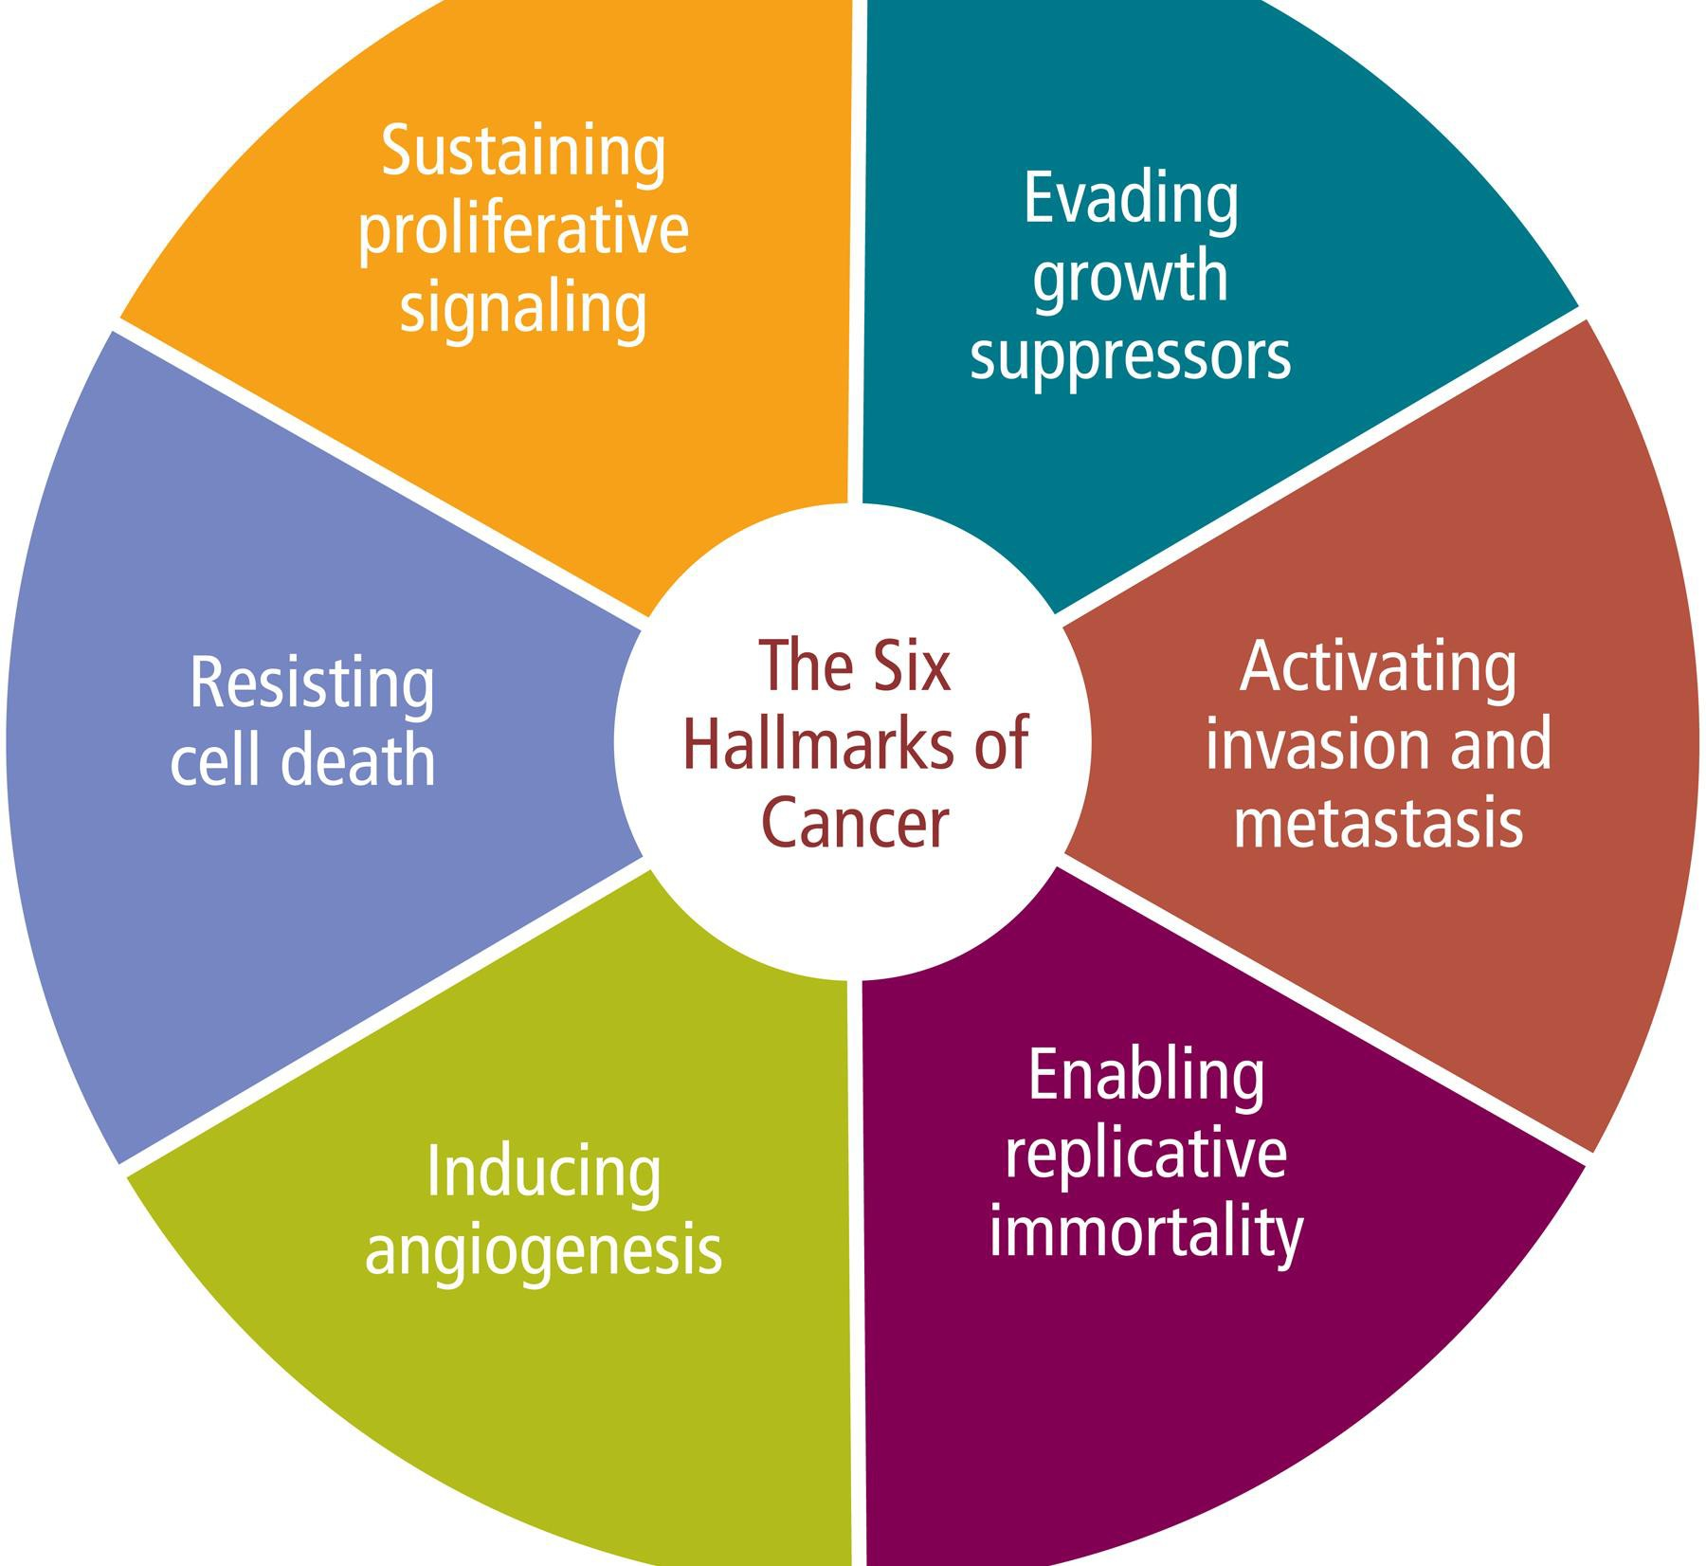
Six Hallmarks of cancer cells
Normal cells transform to a neoplastic state & acquire these
hallmark capabilities
Sustaining proliferative signaling — cancer cells continuously signal to keep dividing.
Evading growth suppressors — bypass controls (e.g., RB, p53) that limit proliferation.
Resisting cell death — avoid apoptosis and other programmed death pathways.
Enabling replicative immortality — maintain telomeres to divide indefinitely
Inducing angiogenesis — stimulate new blood vessels to supply the tumor
Activating invasion and metastasis — acquire motility and invade distant sites.

Slide 19
TME role in cancer progression
Tumor microenvironment
  Plays a major role supporting ‘cell transformation’ & cancer progression, esp. to later stages of cancer
  Endothelial cells form blood vessels & provide cancer cells with blood circulation and oxygen
  The microenvironment can be used as a therapeutic approach as new avenue for treatment (Immunotherapy)
  More in Lecture 4

Slide 20
Continued… other properties of cancer cells
Can involve changes in gene expression
Can involve angiogenesis
So cancer develops in multiple steps

Slide 21
Talib, et. al. 2024. Foods, 13(17), 2687.
  Additional Hallmarks 7, 8, 9

Slide 22
The “hallmarks” are functional capabilities acquired during tumor development
Additional:
Emerging hallmarks
Deregulating cellular energetics — metabolic reprogramming (e.g., increased glycolysis).
Avoiding immune destruction — evading or suppressing anti-tumor immunity.
Enabling characteristics
Genome instability and mutation — increased mutation rate that fuels its evolution.
Tumor-promoting inflammation — inflammatory cells and signals that support tumor growth from the tumor microenvironment

Slide 23
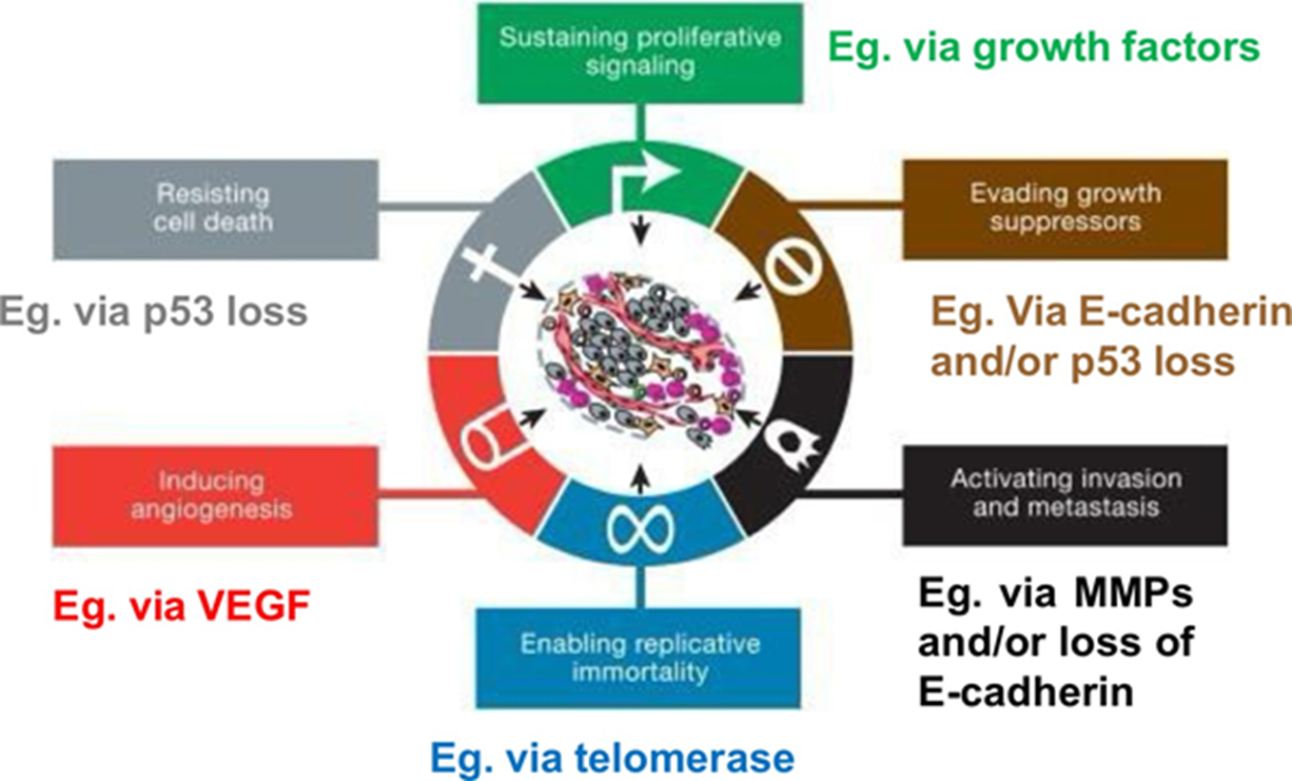
Relevance to Comp Science
Hallmarks (sustained proliferation, evading apoptosis, angiogenesis, etc.) use major signaling pathways (MAPK, PI3K/AKT, p53).
Relevance to comp science:
  Pathway inference, signaling network modeling, drug target identification
Image analysis of Cells and tissue based on morphology
The Hallmarks of Cancer
Hanahan, Douglas et al.
Cell, Volume 100, Issue 1, 57 - 70

Slide 24
Carcinogenesis summary
Genetic Alterations
Hallmarks of Cancer
Mutations in key genes can disrupt normal cell growth and division, leading to uncontrolled proliferation and tumor formation.
Characteristics -
sustained angiogenesis, evasion of apoptosis,
and metastatic potential
define the complex biology of cancers.

Slide 25
End Lecture 1

